Slide 1



Hospital Transactions
View in Power BI
Last data refresh:
12/15/2025 1:14:36 AM UTC
Downloaded at:
12/16/2025 3:54:50 AM UTC

Slide 2
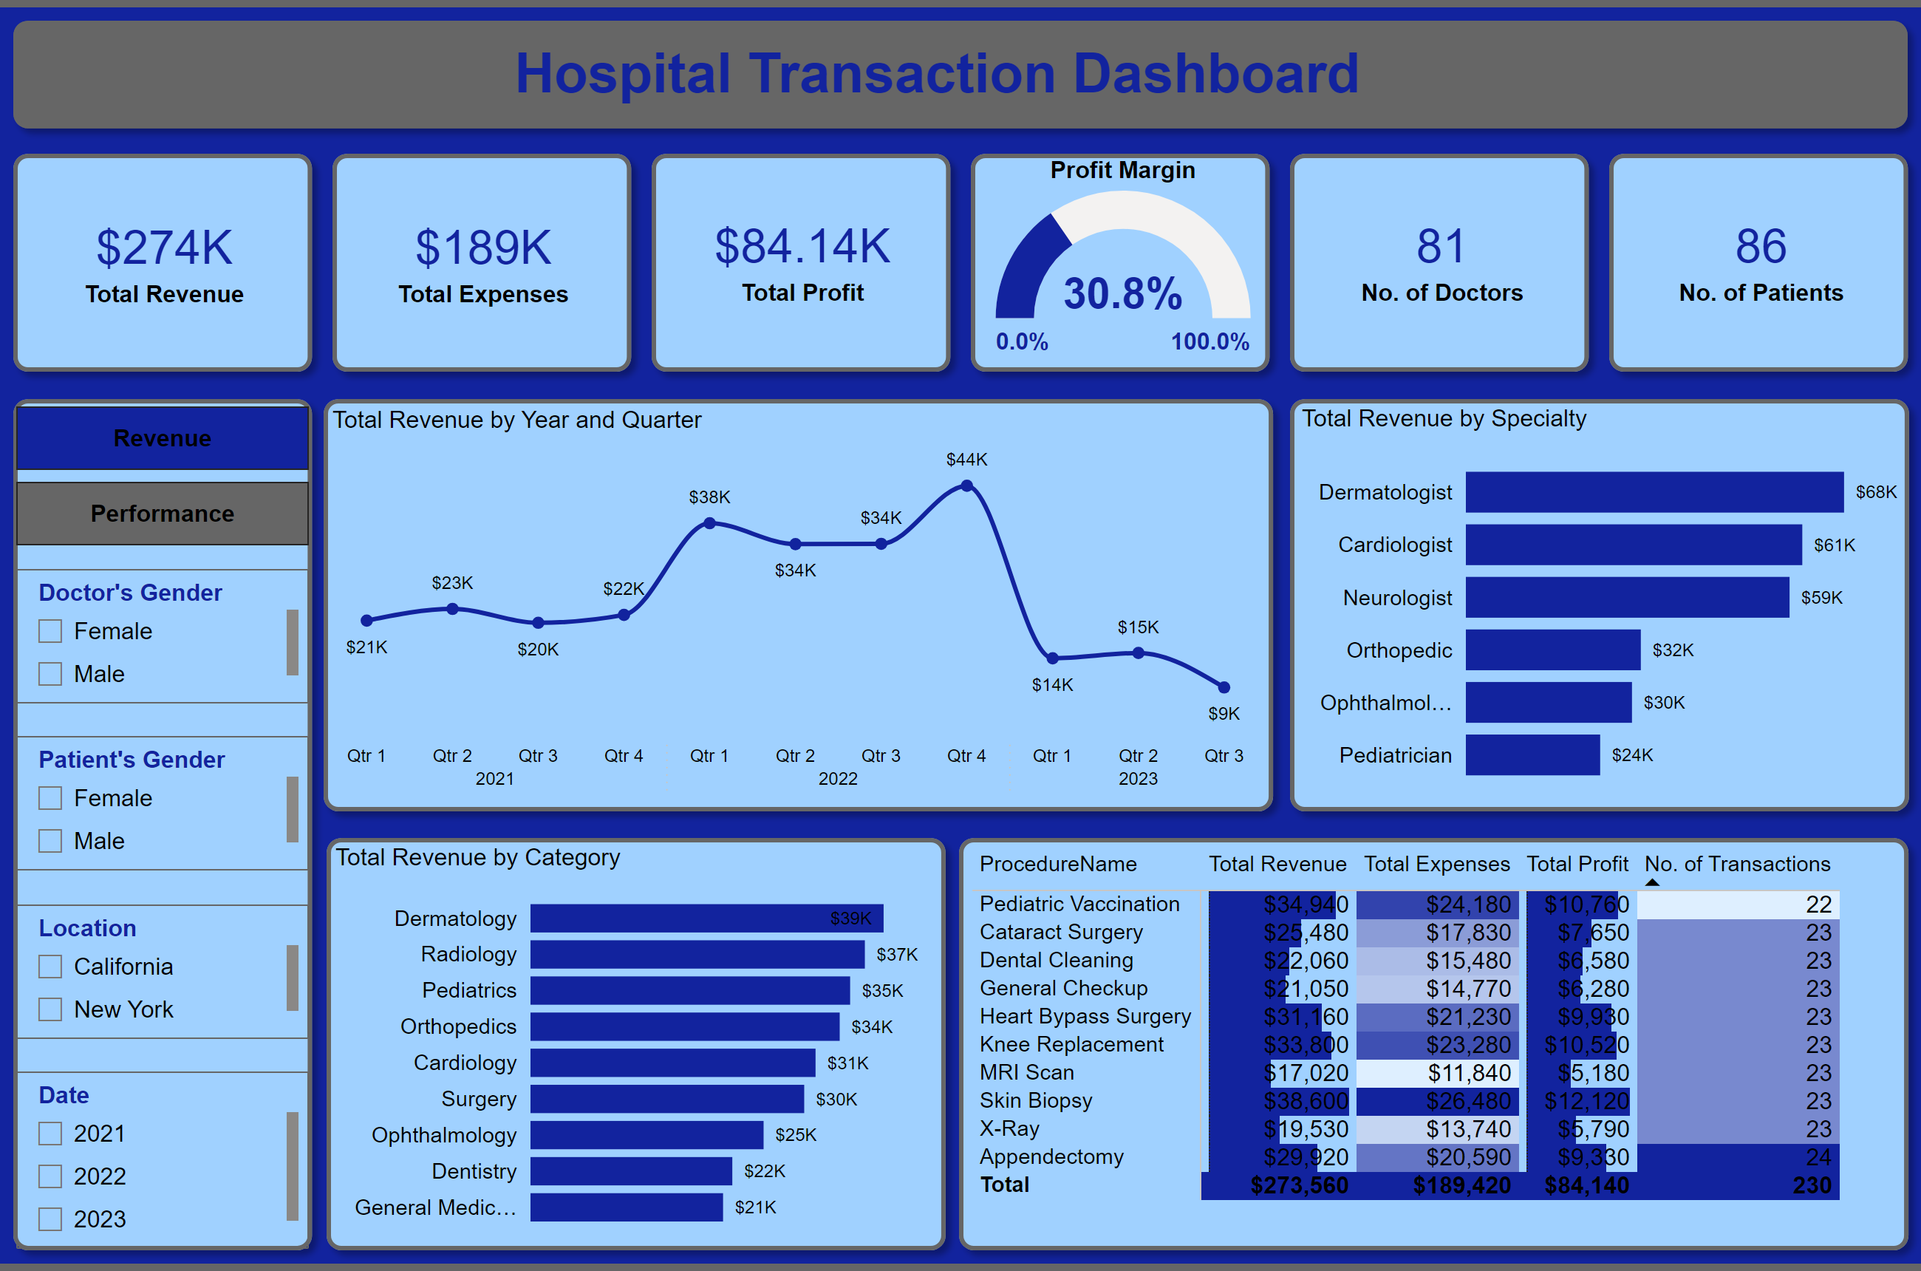
Revenue
Notes:
shape
No alt text provided
shape
No alt text provided
shape
No alt text provided
shape
No alt text provided
shape
No alt text provided
shape
No alt text provided
shape
No alt text provided
shape
No alt text provided
shape
No alt text provided
shape
No alt text provided
shape
No alt text provided
shape
No alt text provided
card
No alt text provided
gauge
No alt text provided
card
No alt text provided
card
No alt text provided
card
No alt text provided
card
No alt text provided
lineChart
No alt text provided
clusteredBarChart
No alt text provided
clusteredBarChart
No alt text provided
pivotTable
No alt text provided
slicer
No alt text provided
slicer
No alt text provided
slicer
No alt text provided
slicer
No alt text provided
textbox
No alt text provided
pageNavigator
No alt text provided

Slide 3
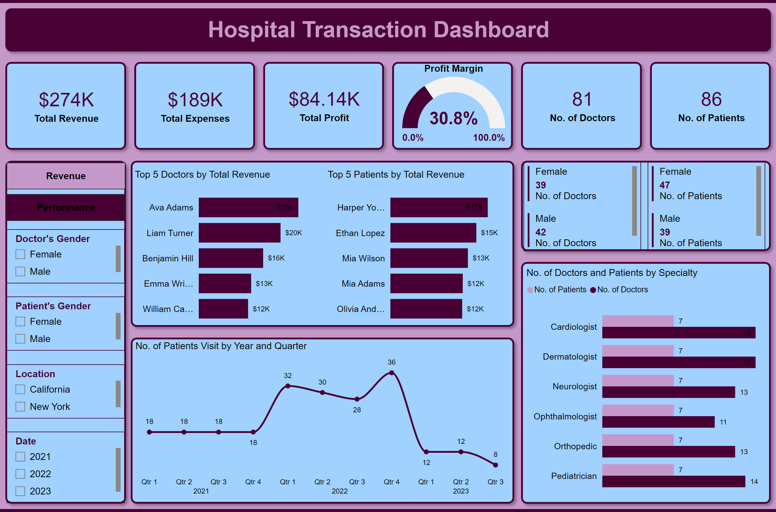
Performance
Notes:
shape
No alt text provided
shape
No alt text provided
shape
No alt text provided
shape
No alt text provided
shape
No alt text provided
shape
No alt text provided
shape
No alt text provided
shape
No alt text provided
shape
No alt text provided
shape
No alt text provided
shape
No alt text provided
shape
No alt text provided
card
No alt text provided
card
No alt text provided
card
No alt text provided
gauge
No alt text provided
card
No alt text provided
card
No alt text provided
slicer
No alt text provided
slicer
No alt text provided
slicer
No alt text provided
slicer
No alt text provided
No. of Patients Visit by Year and Quarter
No alt text provided
Top 5 Doctors by Total Revenue
No alt text provided
Top 5 Patients by Total Revenue
No alt text provided
No. of Doctors and Patients by Specialty
No alt text provided
multiRowCard
No alt text provided
multiRowCard
No alt text provided
textbox
No alt text provided
pageNavigator
No alt text provided

